Slide 1
Tools III: Presence, Interaction, Communication
EDC&I 505 J
25 April 2012

Slide 2
Our Agenda Today
Some notes from AERA
Debrief on 4/11-25 online session
And some thoughts on “presence”
New Tool Presentations (6)
Discuss Horton (Chs. 4, 10); Garrison; Cui
Prepare for 5/2 session
What are “practices”? (And what would make a practice “promising”?)
Preparation for 5/9 synchronous online session
Move 5/29 “Project Check-In” to 5/2

Slide 3
AERA (American Educational Research Association)
Meeting in Vancouver, BC, April 13-17
Many sessions on OL learning/design; gems:
Student “listening styles” in OL discussions vary; high participation ≠ deeper processing (Wise et al.; session 42.066)
More instructor “pedagogical” posts ⇒ more student “critical thinking” posts (Henderson; same)
Students with high “learning presence” are more central and have more interactions (Shea; same)
Discussion boards lead to more “podium talk,” blogs lead to more sociable interaction (but maybe less learning) (Clark; same)
Higher Order Thinking (HOT) = associated with Application, Analysis, and Intellectual Modesty (Howard; same)
OL learning in US HSs: Principals concerned re quality of OL courses, tend to privilege F²F experience (maybe too much) (Day; 54.070)

Slide 4
Debriefing on Our Asynchronous Session
Audience:
How did you feel as you worked on the questions / assignments provided by the presenters?
Presenters:
Did you feel that you were in touch with the audience?
Presence:
(In Catalyst) Did you have a feeling that you were “there,” interacting with other people, working in a virtual space, or did the experience seem impersonal?
(In tools presented) Did you feel “immersed” in the setting, medium, tool?
Did the tool environment feel realistic, “natural,” or was it contrived?
Did you feel engaged, intellectually active as you worked with the tool?
How much time did you spend on the work (compared with what you typically spend on preparing for this or another class)?

Slide 5
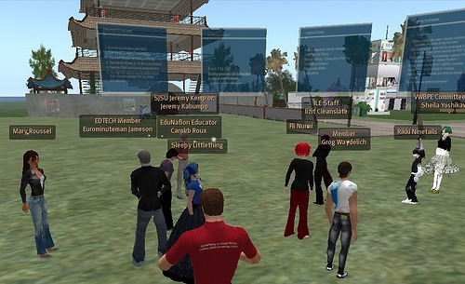
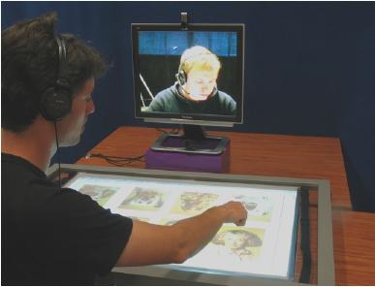
What Provides Presence?
Avatars?
Images?
Activities?
Robotic realism?
(But not via the “uncanny valley”!)

Slide 6
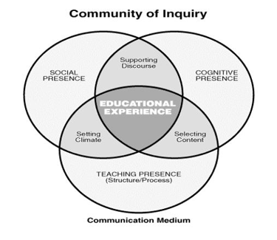
Social Presence and its Components: Specific to Online Learning
Social Presence
Cognitive Presence
Teaching Presence
…Are there others?

Slide 7
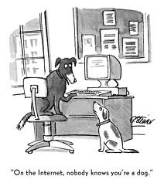
Social Presence More Generally: Trust and Influence
Key elements in social relationships generally, and in online presence
Cf.: “good Samaritans” in online knowledge forums
Related to affiliative tendency, self-esteem, “public individuation”

Slide 8
New Tool Presentations
Saki U.
Liz S.
Alyson B.
Daniel N.
Bill A.
Pamela L.

Slide 9
Questions
Horton, Ch. 4 (“Connect” activities)
Imagine that you are designing online materials to train people in a critical task that affects the safety of others (airline pilot, HazMat team member, police officer). What sorts of “Connect” activities would be most appropriate for particular aspects of their work?
Horton, Ch. 10 (Virtual Classroom)
We’ll be using Adobe Connect for our synchronous session on 5/9. In light of Horton’s discussion of teaching in a virtual classroom, what are the special constraints, tasks that you will need to be aware of in being either a presenter or a participant that evening?
Cui et al.
What factors are most central to your own definition of “social presence” for online learning (or in CMC in general)?
Garrison & Cleveland-Innes
Did the approaches we used in our asynchronous session facilitate a “deep approach” to learning? What could have promoted deeper engagement?

Slide 10
For Next Week
Identify 3 new-to-you OL learning “practices.”
Be ready to describe, and say what you think makes them “promising” approaches
Preparation for 5/9 synchronous online session: If you can, bring a laptop and mic/headphones so we can check the set-up
Bring questions/concerns about your final project or paper for the “Project Check-In”
Read Palloff & Pratt; Koh; Chang

